Slide 1
CHAPTER 7
Multiple Tables:
Joins & Set Operations

Slide 2
IN THIS CHAPTER . . .
You will learn to design queries based on multiple tables.
You will retrieve related data from various tables in a database.
Various types of table joins are discussed.
Set operations UNION, UNION ALL, INTERSECT and MINUS are used.

Slide 3
JOIN
When the required data is in more than one table, related tables are joined using a join condition. The join condition combines a row in one table with a row in another table based on the same values in the common columns. In most cases (but not always), the common columns are the primary key in one table and a foreign key in another.
Cartesian Product
A Cartesian product results from a multitable query that does not have a WHERE clause. The product operation joins each row in the first table with each row in the second table. The product normally results in an output with a large number of rows and is not very useful. Whenever retrieving data from more than one table, you must use a valid join condition(s) to avoid a Cartesian product! You would perform a Cartesian product operation only if you were looking to find all possible combinations of rows from two tables.

Slide 4
Equijoin
The equijoin is a join with a join condition involving common columns from two tables. If you need to get information about a student from the STUDENT table and corresponding information about the faculty advisor from the FACULTY table, you would use the following syntax:
SELECT columnnames
FROM tablenames
WHERE join condition(s);
The column names include columns from both tables separated by commas, table names are all tables used separated by commas, and the join condition is a condition that includes common columns from each table.
The join condition normally (but not always) includes a foreign key column from one table and the referenced primary key column from the other table. Suppose you want to get a student’s last name, the student’s first name, the faculty advisor’s name, and the faculty advisor’s phone number. You would get them from the STUDENT and FACULTY tables. The common column in both tables is FacultyId, which is the foreign key in the child STUDENT table and the primary key in the parent FACULTY table. The join condition will return the requested information from rows in two tables where the FacultyId value is same.

Slide 5
Equijoin
Another thing to be noted is the use of tablename.columnname. When columns are retrieved from more than one table, the use of a table name qualifier in front of the column name tells Oracle to retrieve that column from the table specified. Oracle is pretty smart about it. If a column name exists in only one of the two tables involved in the query, it is not necessary to use a table name as a qualifier. If a column exists in both tables involved, you must use the table name qualifier.
The join condition in an equijoin will normally have the table name qualifier. Because the join condition usually has the same column names from two tables, without a qualifier the column names become ambiguous. The qualifier actually improves performance because you are telling Oracle server where to go to find that column.
Sometimes the required information is in more than two tables. The FROM clause will include all needed tables, and the WHERE clause will have more than one join condition. If you need to join n tables, you would need
n – 1 join conditions.

Slide 6
Table Aliases
Table aliases are used to avoid using lengthy table names over and over again in a query. A table alias can be from 1 to 30 characters long. Normally, very short alias names are used to shorten the query and save some keystrokes.
The table alias appears in the FROM clause of the SELECT query. A table name is written followed by a space, and then a table alias is supplied. Though they appear after the SELECT clause, alias names can be used as qualifiers for column names in the SELECT clause also. All table aliases are valid only in the SELECT query, where they are named and used.
Additional Conditions
In addition to join conditions, you may use additional conditions using the AND operator to restrict information.

Slide 7
Nonequijoin
There is no matching column in the EMPLEVEL table for the Salary column in the EMPLOYEE table. The only possible relationship between two tables is between the Salary column of the EMPLOYEE table and the LowSalary and HighSalary columns in the EMPLEVEL table. The join condition for these tables can be written using any operator other than the = operator. That is why it is called nonequijoin.
The Nonequijoin condition of textbook Fig. 7-6 could have been written as
e.Salary >= l.LowSalary AND e.Salary <= l.HighSalary;

Slide 8
Outer Join
If a row in one table does not have a matching value in the other table, it is not joined. The table that does not contain the matching value is known as the deficient table. The outer join uses the (+) operator in the join condition on the deficient side. You will see it soon in fig. 7-8, which compares equijoin and outer join on these tables. The (+) operator can be used on any side of the join condition, but it can’t be used on both sides in one condition. The general syntax is
SELECT tablename1.columnname, tablename2.columnname
FROM tablename1, tablename2
WHERE tablename1.columnname (+) = tablename2.columnname;
The join condition will look different if the (+) operator is used on the right hand side. For example,
WHERE tablename1.columnname = tablename2.columnname (+);

Slide 9
Self-Join
A self-join is joining a table to itself. It sounds meaningless, but think about it using this scenario. In the EMPLOYEE table, EmployeeId is the primary key column that describes each entity. For example, EmployeeId 200 represents employee Shaw, Jinku. The table also has another column called Supervisor, which contains IDs of employee supervisors. How can you find name of the supervisor for an employee? You can look up the supervisor ID, go to the EmployeeId column to find its match, and then read the name. This is easier said than done. A self-join is one join that is not so easy to understand.
When a table is joined to itself, two copies of the same table are loaded or used. They are treated like any two different tables, and a join is produced from those two copies

Slide 10
SET OPERATORS
In Chapter 1, you learned about union, intersection, and difference operations. If you recall, these operations are possible on “union compatible” tables. The implementation of these operations is through the use of set operators. The union compatibility is achieved or the set operations are performed on results from two independent queries. The output from both queries must return the same number of columns and respective columns must have a similar domain.
The general syntax for any set operation is
SELECT-Query1
Set operator
SELECT-Query2;

Slide 11
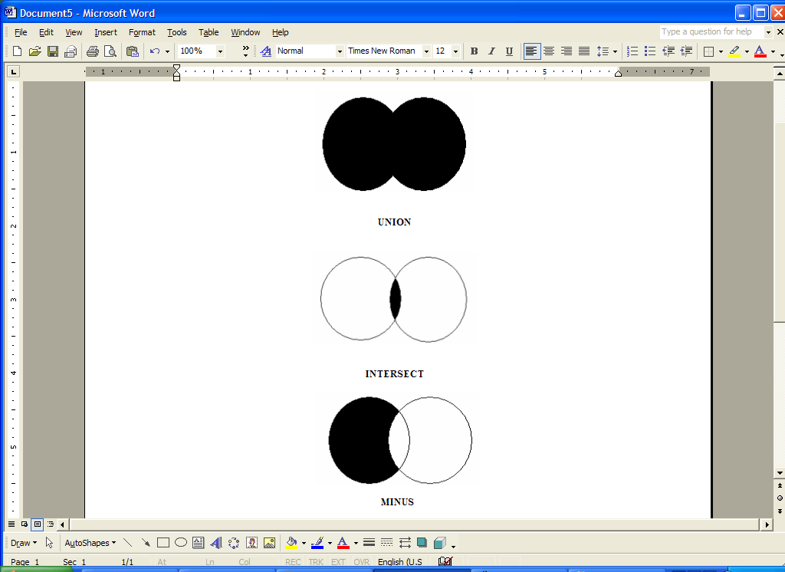
SET OPERATORS
In figure, set operators UNION, INTERSECT and MINUS are shown using Venn diagrams. The left circle represents the first table and the right circle represents the second table. The shaded area is the area selected by each operation. The UNION operator selects all rows from the first table as well as the second table, so the entire circles are shaded. The INTERSECT operator selects rows present in both tables, so the common area is shaded. The MINUS operator selects rows in the first table that are not present in the second table, so the area exclusively belonging to the first table is shaded

Slide 12
UNION
The UNION operator takes output from two queries and returns all rows from both results. The duplicate rows are displayed only once. If you perform union on two very large tables, use a WHERE clause to filter rows. All six student’s rows are selected from the first query and four rows are selected from the second query. Two rows from the second query are duplicate rows, and they are not repeated (ID 00103 and ID 00105). Figure 7-12 lists all students and staff members in the result.
UNION ALL
The UNION ALL operation is similar to the UNION operation. The only difference is that UNION ALL operation displays duplicate rows also. If you find UNION ALL of the STUDENT and WORKER tables, you will get six rows from the first query and six rows from the second query (see Fig. 7-13).

Slide 13
INTERSECT
The INTERSECT operation works on output from two separate queries and returns rows that appear in both outputs. In the student and worker example, INTERSECT will return students who are also workers in the college. In Fig. 7-14, you see only two student rows, which are the only students appearing in the WORKER table.
MINUS
The MINUS operation is same as the difference operation covered in Chapter 1. When MINUS is performed on outputs from two queries, the result is the rows in the first query’s result that are not in the second query’s result. Remember that the STUDENT table minus the WORKER table is not same as the WORKER table minus the STUDENT table. Figure 7-15 is an example of a minus operation in which the result includes students who are not workers. Figure 7-16 shows workers who are not students.

